Slide 1

REVIEW PART IV - jQuery
Ranken Technical College

Slide 2
Objectives
jQuery CDN vs. Download
Understand Basic jQuery Selectors
Using Event Handling in jQuery
Add vs. Remove vs. Toggle Classes
Using jQuery for Form Validation
Using jQuery for CRUD

Slide 3
Using jQuery via a CDN
A content delivery network (CDN) is a geographically distributed network of proxy servers and their data centers
Using a CDN means that you do not have to physically download jQuery on your system
However, you must have Internet access to use jQuery from a CDN

Slide 4
jQuery CDN Advantages
Advantages of jQuery via a CDN:
Faster delivery of content
More simultaneous users
Constant availability
Reliable delivery of content
Constant availability

Slide 5
jQuery CDN Disadvantages
Disadvantages of jQuery via a CDN:
Hidden costs
Location of services
Restrictions
Support availability
Loss of control
Need Internet access

Slide 6
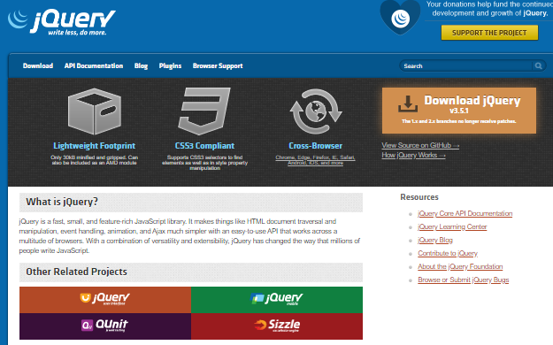
jQuery Website
The jQuery website, located at URL: https://jquery.com/ is simple but functional

Slide 7
jQuery Selectors
See URL: https://api.jquery.com/category/selectors/ for the (currently) 60+ different jQuery selectors. Some of the major selectors are discussed next

Slide 8
Child Selector
jquery("parent > child")
Description:
Selects all direct child elements specified by "child" of elements specified by "parent". The child combinator (E > F) can be thought of as a more specific form of the descendant combinator (E F) in that it selects only first-level descendants
Source
https://api.jquery.com/child-selector/

Slide 9
Class Selector
jquery(".class")
Description:
Selects all elements with the given class. For class selectors, jQuery uses the native JavaScript getElementsByClassName() function if the browser supports it
Source
https://api.jquery.com/class-selector/

Slide 10
Descendant Selector
jquery("ancestor descendant")
Description:
Selects all elements that are descendants of a given ancestor. A descendant of an element could be a child, grandchild, great-grandchild, etc. of that element
Source
https://api.jquery.com/descendant-selector/

Slide 11
Element Selector
jquery("ancestor descendant")
Description:
Selects all elements that are descendants of a given ancestor. A descendant of an element could be a child, grandchild, great-grandchild, etc. of that element
Source
https://api.jquery.com/element-selector/

Slide 12
:first-child Selector
jquery(":first-child")
Description:
Selects all elements that are descendants of a given ancestor. A descendant of an element could be a child, grandchild, great-grandchild, etc. of that element
Source
https://api.jquery.com/first-child-selector/

Slide 13
ID Selector
jquery("#id")
Description:
Selects a single element with the given id attribute
Source
https://api.jquery.com/id-selector/

Slide 14
:last-child Selector
jquery(":first-child")
Description:
Selects all elements that are the last child of their parent. While .last() matches only a single element, :last-child can match more than one element for each parent
Source
https://api.jquery.com/last-child-selector/

Slide 15
:nth-child Selector
jquery("nth-child" (n))
Description:
Selects all elements that are the nth-child of their parent
Source
https://api.jquery.com/nth-child-selector/

Slide 16
Next Adjacent Selector
jquery("prev + next")
Description:
Selects all next elements matching "next" that are immediately preceded by a sibling "prev". The elements on either side of the combinator must share the same parent
Source
https://api.jquery.com/next-adjacent-selector/

Slide 17
Next Siblings Selector
jquery("prev ~ siblings")
Description:
Selects all sibling elements that follow after the "prev" element, have the same parent, and match the filtering "siblings" selector
Source
https://api.jquery.com/next-siblings-selector/

Slide 18
Parent Selector
jquery(":parent")
Description:
Selects all elements that have at least one child node (either an element or text). The inverse of the :empty selector
Source
https://api.jquery.com/parent-selector/

Slide 19
jQuery Event Handling
See URL: https://learn.jquery.com/events/handling-events/ for info on jQuery event handlers. Some of the major event handlers are discussed next

Slide 20
.bind()
Description:
Attaches a handler to an event for elements
Source
https://api.jquery.com/bind/

Slide 21
.change()
Description:
Binds an event handler to the "change" JavaScript event, or triggers that event on an element
Source
https://api.jquery.com/change/

Slide 22
.change()
Description:
Binds an event handler to the "change" JavaScript event, or triggers that event on an element
Source
https://api.jquery.com/change/

Slide 23
.click()
Description:
Binds an event handler to the "click" JavaScript event, or triggers that event on an element
Source
https://api.jquery.com/clixk/

Slide 24
.each()
Description:
Iterates over a jQuery object, executing a function for each matched element
Source
https://api.jquery.com/each/

Slide 25
.error()
Description:
Binds an event handler to the "error" JavaScript event
Source
https://api.jquery.com/error/

Slide 26
.event.preventDefault()
Description:
If this method is called, the default action of the event will not be triggered
Source
https://api.jquery.com/event.preventDefault

Slide 27
.event.stopPropagation()
Description:
Prevents the event from bubbling up the DOM tree, preventing any parent handlers from being notified of the event
Source
https://api.jquery.com/event.stopPropagation

Slide 28
.on()
Description:
Attaches an event handler function for one or more events to the selected elements
Source
https://api.jquery.com/on

Slide 29
.on("reset")
Description:
Used with on, the reset event here is often used to remove any error messages that arise when a form is in the validation process
Source
https://api.jquery.com/on

Slide 30
.submit()
Description:
Binds an event handler to the "submit" JavaScript event, or triggers that event on an element
Source
https://api.jquery.com/submit

Slide 31
jQuery Class Methods
jQuery provides several methods, such as addClass(), removeClass(), and toggleClass() to manipulate the CSS classes assigned to HTML elements
These methods are often (but not exclusively) used with jQuery animation()
Source
https://www.tutorialrepublic.com/jquery-tutorial/jquery-add-and-remove-css-classes.php

Slide 32
addClass()
The jQuery addClass() method adds >= 1 classes to selected elements
Example:
$("span.test").next().addClass("one");

Slide 33
removeClass()
The jQuery removeClass() method removes >= 1 classes from selected elements
Example:
$("span.test").next().removeClass("one");

Slide 34
toggleClass()
The jQuery toggleClass() adds or removes >= 1 class from the selected elements. If the selected element already has the class, it is removed. If an element does not have the class, it is added
Example:
$("span.test").next().toggleClass("one");

Slide 35
jQuery Form Validation
The programmer can write his/her own jQuery form validation code, or s/he can use a plug-in such as the jQuery Validation Plugin

Slide 36
jQuery And CRUD
CRUD is an acronym for Create, Read, Update, Delete. It is often used with database-driven applications
The programmer can write his/her own jQuery CRUD application code, or s/he can use a plug-in such as EasyUI

Slide 37
What We Covered
Using jQuery with/without a CDN
Basic jQuery Selectors
Event Handling in jQuery
jQuery addClass, removeClass, and toggleClass() methods
jQuery and Form Validation
jQuery and CRUD applications

Slide 38
Some Useful URLs
https://jquery.com/
https://developer.mozilla.org/en-US/docs/Glossary/jQuery
https://www.w3schools.com/jquery/

